Slide 1
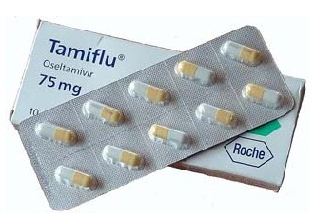
Antiviral Drugs
Principles of Medical Virology - Chapter 5

Slide 2
Definition
Antiviral drugs are a class of medication used specifically for treating viral infections.
Like antibiotics for bacteria, specific antivirals are used for specific viruses.
Unlike most antibiotics, antiviral drugs do not destroy their target pathogen; instead they inhibit their development.

Slide 3
History
Through the mid- to late-20th century, medical science and practice included an array of effective tools, ranging from antiseptics to vaccines and antibiotics, but no drugs to treat viral infections.
While vaccines proved effective in preventing many viral diseases, they could not help once a viral infection set in. Prior to the development of antivirals, when someone contracted a virus, there was little that could be done other than treating the symptoms and waiting for the disease to run its course.

Slide 4
History
Before 1975, specific and effective antiviral therapy was not thought possible because viruses are obligate intracellular parasites, relying on host cells to replicate.
It was thought that any antiviral drug inhibiting viral replication would affect cellular metabolism, leading to cell injury or even death.
The breakthrough occured when the structure of certain viral-encoded enzymes was shown to differ from the corresponding cellular enzymes.

Slide 5
History
The first experimental antivirals were developed in the 1960s, mostly to deal with herpes viruses, and were found using traditional trial-and-error drug discovery methods. Researchers grew cultures of cells and infected them with the target virus. They then introduced into the cultures chemicals which they thought might inhibit viral activity, and observed whether the level of virus in the cultures rose or fell.
This was a very time-consuming, hit-or-miss procedure, and in the absence of a good knowledge of how the target virus worked, it was not efficient in discovering effective antivirals which had few side effects. Only in the 1980s, when the full genetic sequences of viruses began to be unraveled, researchers began to learn how viruses worked in detail, and what chemicals were needed.
As of 2011 dozens of antiviral treatments are available, and medical research is rapidly exploiting new knowledge and technology to develop more.

Slide 6
Virus life cycle
Viruses consist of a genome and sometimes a few enzymes stored in a capsule made of protein (called a capsid), and sometimes covered with a lipid layer (sometimes called an 'envelope').
Viruses cannot reproduce on their own, and instead propagate by subjugating a host cell to produce copies of themselves, thus producing the next generation.
Researchers working on such "rational drug design" strategies for developing antivirals have tried to attack viruses at every stage of their life cycles

Slide 7
Viral life cycles vary in their precise details depending on the species of virus, but they all share a general pattern:
Attachment to a host cell.
Release of viral genes and possibly enzymes into the host cell.
Replication of viral components using host-cell machinery.
Assembly of viral components into complete viral particles.
Release of viral particles to infect new host cells.

Slide 8
Limitations of vaccines
Vaccines are very effective on stable viruses, but are of limited use in treating a patient who has already been infected.
They are also difficult to successfully deploy against rapidly mutating viruses, such as influenza (the vaccine for which is updated every year) and HIV.
Antiviral drugs are particularly useful in these cases.

Slide 9
Anti-viral targeting
The general idea behind modern antiviral drug design is to identify viral proteins, or parts of proteins, that can be disabled.
These "targets" should generally be as unlike any proteins or parts of proteins in humans as possible, to reduce the likelihood of side effects.
The targets should also be common across many strains of a virus, or even among different species of virus in the same family, so a single drug will have broad effectiveness.
For example, a researcher might target a critical enzyme synthesized by the virus, but not the patient, that is common across strains, and see what can be done to interfere with its operation.

Slide 10
Anti-viral targeting
Once targets are identified, candidate drugs can be selected, either from drugs already known to have appropriate effects, or by actually designing the candidate at the molecular level with a computer-aided design program.
The target proteins can be manufactured in the lab for testing with candidate treatments by inserting the gene that synthesizes the target protein into bacteria or other kinds of cells. The cells are then cultured for mass production of the protein, which can then be exposed to various treatment candidates and evaluated with "rapid screening" technologies.

Slide 11
Before cell entry
One anti-viral strategy is to interfere with the ability of a virus to infiltrate a target cell.
The virus must go through a sequence of steps to do this, beginning with binding to a specific "receptor" molecule on the surface of the host cell and ending with the virus "uncoating" inside the cell and releasing its contents.
Viruses that have a lipid envelope must also fuse their envelope with the target cell, or with a vesicle that transports them into the cell, before they can uncoat.
Using agents which mimic the virus-associated protein (VAP), natural ligands of the receptor or anti-receptor antibodies

Slide 12
Entry inhibitor
A very early stage of viral infection is viral entry, when the virus attaches to and enters the host cell.
A number of "entry-inhibiting" or "entry-blocking" drugs are being developed to fight HIV.
HIV most heavily targets the immune system's white blood cells known as "helper T cells", and identifies these target cells through T-cell surface receptors designated "CD4" and "CCR5".
Attempts to interfere with the binding of HIV with the CD4 receptor have failed to stop HIV from infecting helper T cells, but research continues on trying to interfere with the binding of HIV to the CCR5 receptor in hopes that it will be more effective.

Slide 13
Uncoating inhibitor
Inhibitors of uncoating have also been investigated.
Amantadine and rimantadine, have been introduced to combat influenza. These agents act on penetration/uncoating.
Pleconaril works against rhinoviruses, which cause the common cold, by blocking a pocket on the surface of the virus that controls the uncoating process. This pocket is similar in most strains of rhinoviruses and enteroviruses, which can cause diarrhea, meningitis, conjunctivitis, and encephalitis.

Slide 14
During viral synthesis
Reverse transcription
Integrase
Transcription
Translation / antisense
Translation / ribozymes
Protease inhibitors

Slide 15
Reverse transcription (1)
One way of doing this is to develop nucleotide or nucleoside analogues that look like the building blocks of RNA or DNA, but deactivate the enzymes that synthesize the RNA or DNA once the analogue is incorporated. This approach is more commonly associated with the inhibition of reverse transcriptase (RNA to DNA) than with "normal" transcriptase (DNA to RNA).
The first successful antiviral, acyclovir, is a nucleoside analogue, and is effective against herpesvirus infections. The first antiviral drug to be approved for treating HIV, zidovudine (AZT), is also a nucleoside analogue.

Slide 16
Reverse transcription (2)
An improved knowledge of the action of reverse transcriptase has led to better nucleoside analogues to treat HIV infections. One of these drugs, lamivudine, has been approved to treat hepatitis B, which uses reverse transcriptase as part of its replication process. Researchers have gone further and developed inhibitors that do not look like nucleosides, but can still block reverse transcriptase.
Another target being considered for HIV antivirals include RNase H - which is a component of reverse transcriptase that splits the synthesized DNA from the original viral RNA.

Slide 17
Transcription
Once a virus genome becomes operational in a host cell, it then generates messenger RNA (mRNA) molecules that direct the synthesis of viral proteins.
Production of mRNA is initiated by proteins known as transcription factors.
Several antivirals are now being designed to block attachment of transcription factors to viral DNA.

Slide 18
Translation / antisense
Genomics has not only helped find targets for many antivirals, it has provided the basis for an entirely new type of drug, based on "antisense" molecules. These are segments of DNA or RNA that are designed as complementary molecule to critical sections of viral genomes, and the binding of these antisense segments to these target sections blocks the operation of those genomes.
A phosphorothioate antisense drug named fomivirsen has been introduced, used to treat opportunistic eye infections in AIDS patients caused by cytomegalovirus, and other antisense antivirals are in development.
An antisense structural type that has proven especially valuable in research is morpholino antisense.
Morpholino oligos have been used to experimentally suppress many viral types: caliciviruses, flaviviruses (WNV, dengue, HCV), coronaviruses.

Slide 19
Translation / ribozymes
Yet another antiviral technique inspired by genomics is a set of drugs based on ribozymes, which are enzymes that will cut apart viral RNA or DNA at selected sites. In their natural course, ribozymes are used as part of the viral manufacturing sequence, but these synthetic ribozymes are designed to cut RNA and DNA at sites that will disable them.
A ribozyme antiviral to deal with hepatitis C has been suggested, and ribozyme antivirals are being developed to deal with HIV. An interesting variation of this idea is the use of genetically modified cells that can produce custom-tailored ribozymes. This is part of a broader effort to create genetically modified cells that can be injected into a host to attack pathogens by generating specialized proteins that block viral replication at various phases of the viral life cycle.

Slide 20
Protease inhibitors
Some viruses include an enzyme known as a protease that cuts viral protein chains apart so they can be assembled into their final configuration.
HIV includes a protease, and so considerable research has been performed to find "protease inhibitors" to attack HIV at that phase of its life cycle.
Protease inhibitors became available in the 1990s and have proven effective, though they can have unusual side effects, for example causing fat to build up in unusual places.
Improved protease inhibitors are now in development.
Protease inhibitors have also been seen in nature. A protease inhibitor was isolated from the Shiitake mushroom (Lentinus edodes). The presence of this may explain the Shiitake mushrooms noted antiviral activity in vitro.

Slide 21
Release Phase
The final stage in the life cycle of a virus is the release of completed viruses from the host cell, and this step has also been targeted by antiviral drug developers.
Two drugs named zanamivir (Relenza) and oseltamivir (Tamiflu) that have been recently introduced to treat influenza prevent the release of viral particles by blocking a molecule named neuraminidase that is found on the surface of flu viruses, and also seems to be constant across a wide range of flu strains.

Slide 22
Immune system stimulation
A second category of tactics for fighting viruses involves encouraging the body's immune system to attack them, rather than attacking them directly. Some antivirals of this sort do not focus on a specific pathogen, instead stimulating the immune system to attack a range of pathogens.
One of the best-known of this class of drugs are interferons, which inhibit viral synthesis in infected cells. One form of human interferon named "interferon alpha" is well-established as part of the standard treatment for hepatitis B and C, and other interferons are also being investigated as treatments for various diseases.
A more specific approach is to synthesize antibodies, protein molecules that can bind to a pathogen and mark it for attack by other elements of the immune system. Once researchers identify a particular target on the pathogen, they can synthesize quantities of identical "monoclonal" antibodies to link up that target. A monoclonal drug is now being sold to help fight respiratory syncytial virus in babies, and antibodies purified from infected individuals are also used as a treatment for hepatitis B.

Slide 23
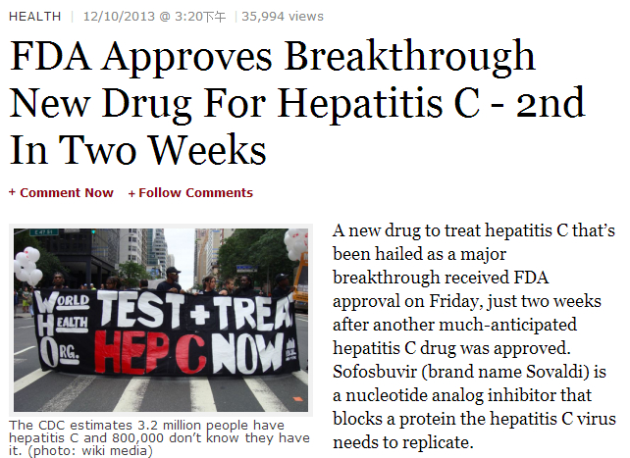
New drugs

Slide 24
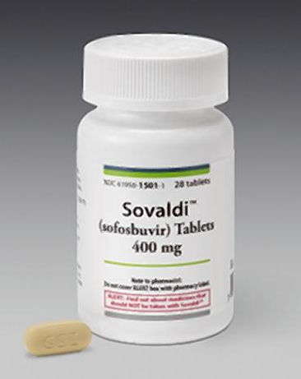
Sofosbuvir (brand name Sovaldi)
SOVALDI is a hepatitis C virus (HCV) nucleotide analog NS5B polymerase inhibitor;
Use together with ribavarin;
No inteferon needed.
It was discovered at Pharmasset and developed by Gilead Sciences.

Slide 25
Simeprevir (brand name Olysio)
Protease inhibitor
The third protease inhibitor drug for the treatment of Hep C.
The other 2: boceprevir (brand name Victrelis, made by Merck) and telaprevir (brand name Incivek, made by Vertex)
Must be used with interferon

Slide 26
考试要求
本次考试为开卷考试，可以使用电脑、手机、网络等信息工具；
5题中选4题完成；
可当堂完成，也可携带考卷回去自行完成；
携带考卷回去完成的同学，请于下次上课时交卷给老师；
无论是考场上或回去自行完成时，严禁互相讨论抄袭，如发现严重雷同，算做作弊。

Slide 27
简述医学病毒的研究范围，以及学习医学病毒的意义。
简述虫媒病毒(Arbovirus)的生命周期，以及黄病毒(Flavivirus)的危害。
简述肠道病毒(enterovirus)的基因组结构，以及相关基因的功能。
简述生物恐怖主义中可能被利用或改造的病毒，以及使它们成为恐怖主义可能利用目标的特性。
谈谈你对病毒学研究的看法，如果你成为一名病毒学博士生，希望从事的方向及其原因。

